Slide 1
Resources for safe prescribing
Kristin Gray
Medicines Information Manager
Auckland City Hospital Pharmacy
January 2018
Notes:
This is going to be an introduction to human and broad resources which can help support

Slide 2
The role of the pharmacist
Clinical Pharmacists
- Ward-based or team-based
Medicines Information departments
Larger hospitals
Good knowledge on the existence of local policies and general drug information
Clinical support
Notes:
There are many places that you’ll see a pharmacist – not just in a community pharmacy. In a hospital setting we have a clinical support role in the MDT, attending ward round and assisting with prescribing advice, drug monitoring, counseling and medicines reconciliation. At larger hospitals such as Auckland, we are lucky enough to have a Medicines Information department which specifically deals with enquiries related to ADHB patients offering advice from adverse effects and interactions to sourcing a drug, funding, pregnancy and breastfeeding all the way to herbal medicines – we can answer your question on the spot, do a literature search and even write you a referenced letter to put in the notes.

Slide 3
Introduction to Resources
What are they? (Why do I need to learn about them?)
Where are they? (How do I access them?)
Are they any good? (When would I use them?)
Notes:
So why am I here? Well with my Medicines Information hat on, I’m here to give you some handy hints and tricks to steer your way through a consultant ward round.
You know the drug but what about the dose, duration, side-effects, interactions….? Where can I find this?

Slide 4
Guidelines and Formularies
A guideline is usually disease or treatment orientated and aims to reflect current best practice
A formulary is drug –orientated and contains summary drug information which aims to aid treatment decisions
Notes:
Guideline may be local, regional, national or international best practice

Slide 5
How is this relevant to me?
Guidelines help with clinical decision-making
Formularies can provide additional information about medicines
Both may influence the medicines you have available to you to prescribe
Having knowledge of where to find these resources will help you when you are prescribing as a junior doctor
Notes:
You may have heard the story in the news last year. In Wairarapa an 82 year old man was admitted for stroke. The house –officer followed the stroke protocol which said to use a tissue plasminogen activator for thrombolysis. He incorrectly administered tenectaplase rather than alteplase and unfortuantely the patient died.
This highlights that guidelines don’t replace clinical judgment. Sometimes all the guidelines in the world can’t help and its important to know that you can always phone a friend, whether that’s a senior colleague or a pharmacist

Slide 6
Clinical scenario Alcohol and Drug Dependence Disorders (Pysch03)
You are the overnight house officer at the ED in Thames Hospital. A 54-year old with a history of chronic alcohol use is admitted after being found collapsed and comatose following the ingestion of two bottles of rum. You diagnose acute alcohol intoxication but want to prevent withdrawal.
What do you prescribe?
- Are there any hospital guideline or protocols to guide you?

Slide 7
ADHB
Notes:
So heres where we access all of the guidelines

Slide 8
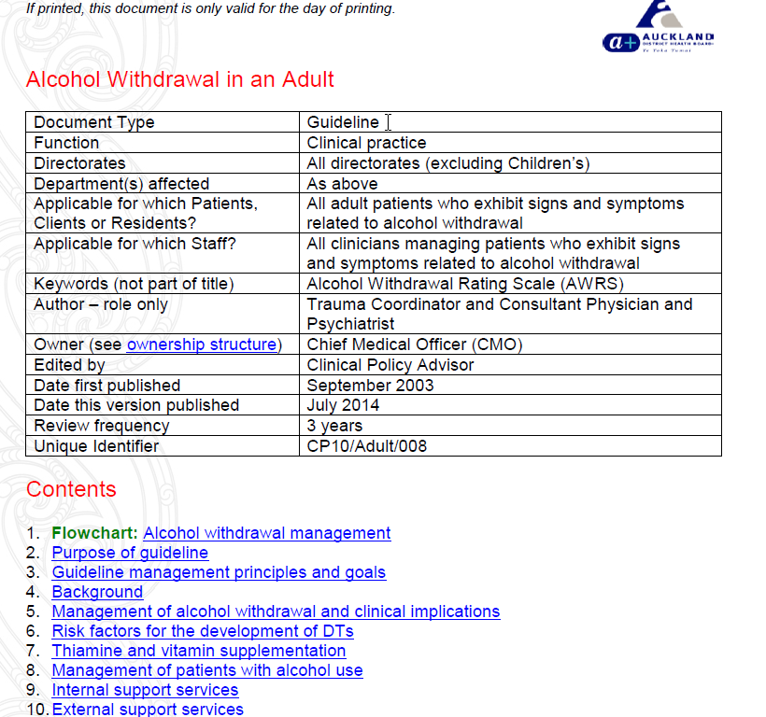

Slide 9
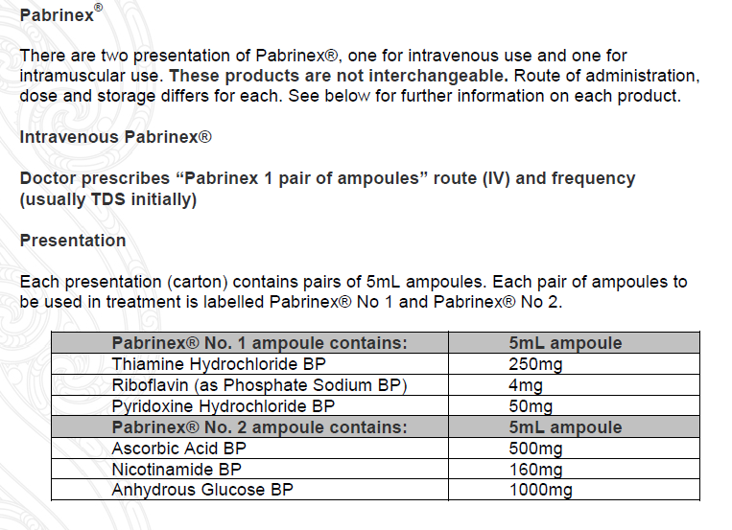

Slide 10
Local hospital guidelines
Developed for use locally (in this case within Auckland District Health Board)
Easily accessible
Contain supporting evidence for current best practice
Peer-reviewed
Regularly updated (every ~3 years)
Notes:
Local guidelines may vary from hospital to hospital

Slide 11
RMO Handbook
Targeted at First Year House Officers
Readily accessible, locally appropriate information
Enable efficient provision of good care to patients with unfamiliar problems
ADHB

Slide 12
Notes:
Also has note to see AWS guideline

Slide 13
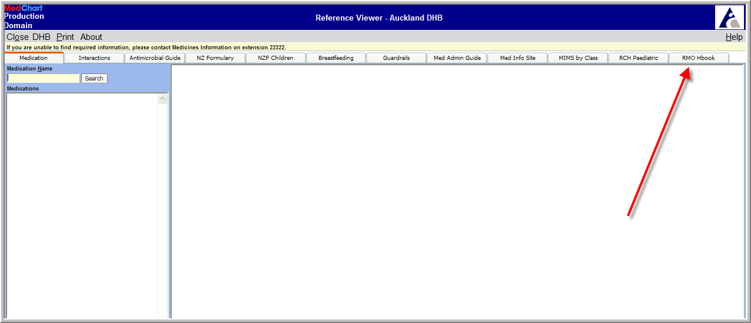
ADHB Reference Viewer

Slide 14
Hospital Specific
National

Slide 15
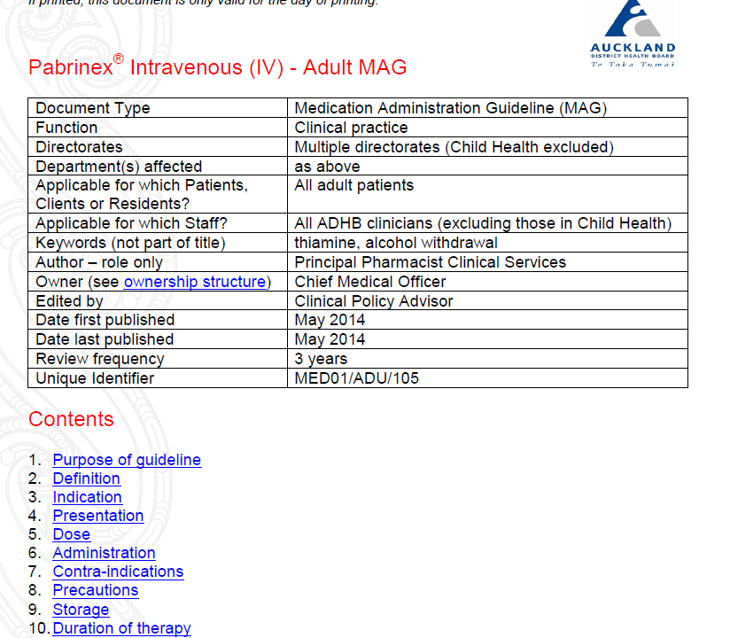

Slide 16
Medicines Administration Guidelines
Developed to aid with process of administration, usually parenteral but other routes
Used widely by nursing staff
Also accompanied with Notes on Injectable Drugs (NOIDs) NZ Hospital Pharmacist Association
Notes:
When do I need to use these? You’re in Resus its 11pm– you need to know now whether its an IV infusion vs. rapid bolus…. The nurse is busy…. The nurse doesn’t know….

Slide 17
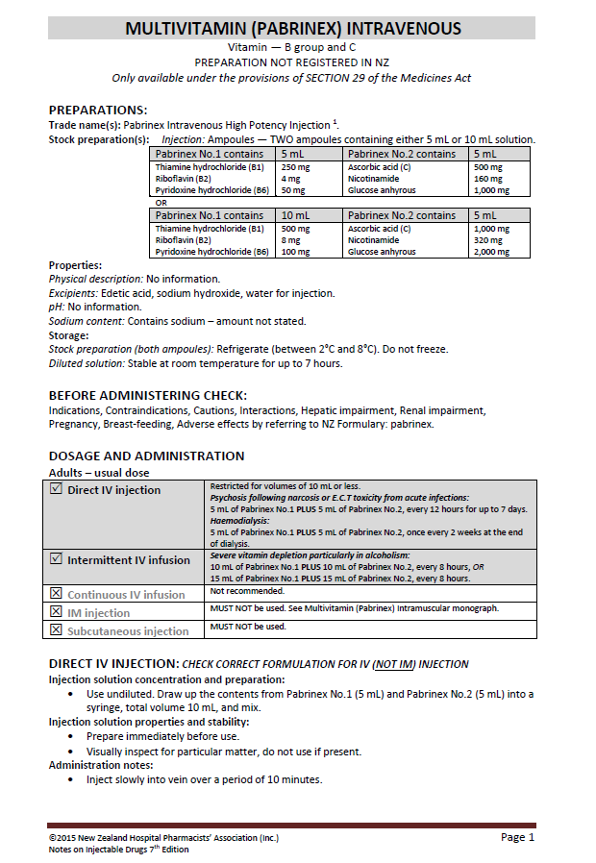

Slide 18
Clinical scenario Sudden onset shortness of breath (Resp04)
A 17 year old Tokelauan woman is admitted with an acute exacerbation of asthma. On the post-acute ward round the consultant asks you to prescribe Singulair

Slide 19
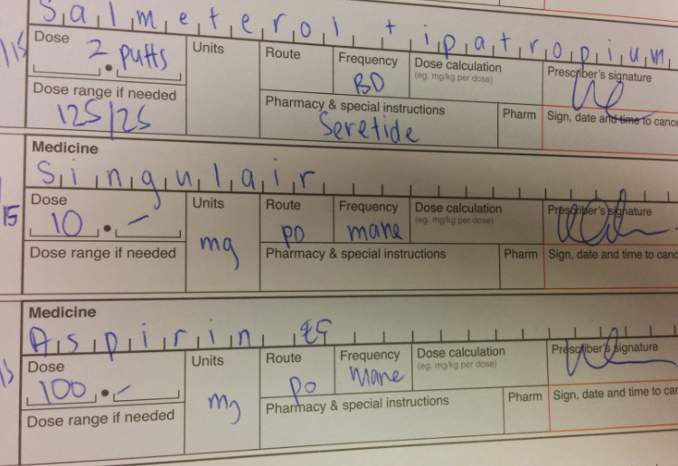
Notes:
Diligantly you write singular

Slide 20
Clinical scenario Sudden onset shortness of breath (Resp04)
A 17 year old Tokelauan woman is admitted with an acute exacerbation of asthma. On the post-acute ward round the consultant asks you to prescribe “Singulair”
What is Singulair?
What’s the dose?
Any side effects?
Any interactions?
Is there a resource to help you?
Notes:
As a doctor its important to always know what drug you are prescribing or the basics at least. If you do it wrong its not going to be the consultant who suggested it who gets the rap – it’ll be the doctor who prescribed it. Don’t always go on brand name, because as we know these change frequently and may be confused with other medicines.

Slide 21
New Zealand Formulary
Launched July 2012
Four main components:
general notes on medicines use
practical notes on specific therapeutic categories
detailed monographs of individual medicines
details of preparations available and relevant subsidy information

Slide 22
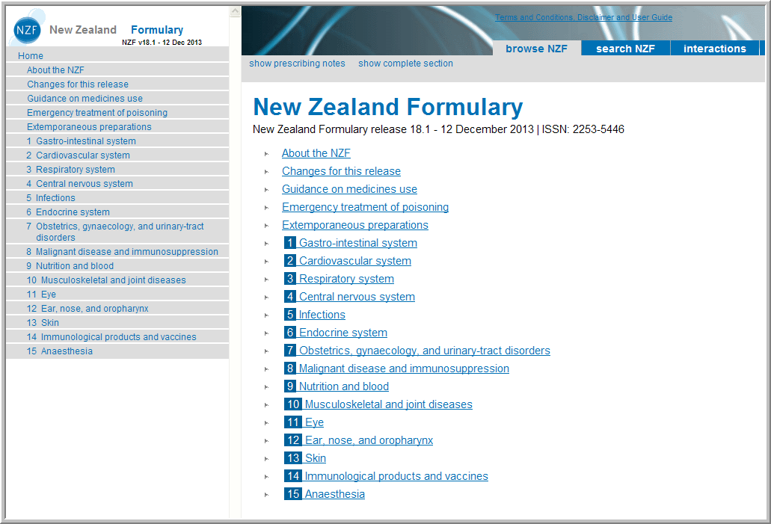
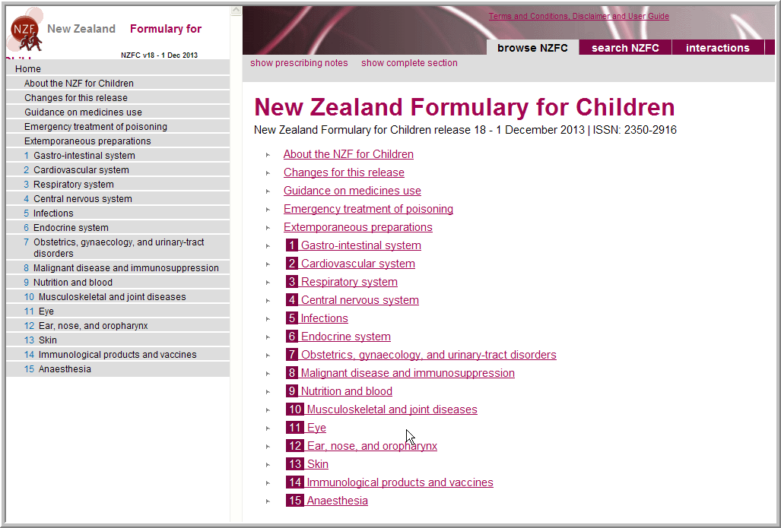

Slide 23
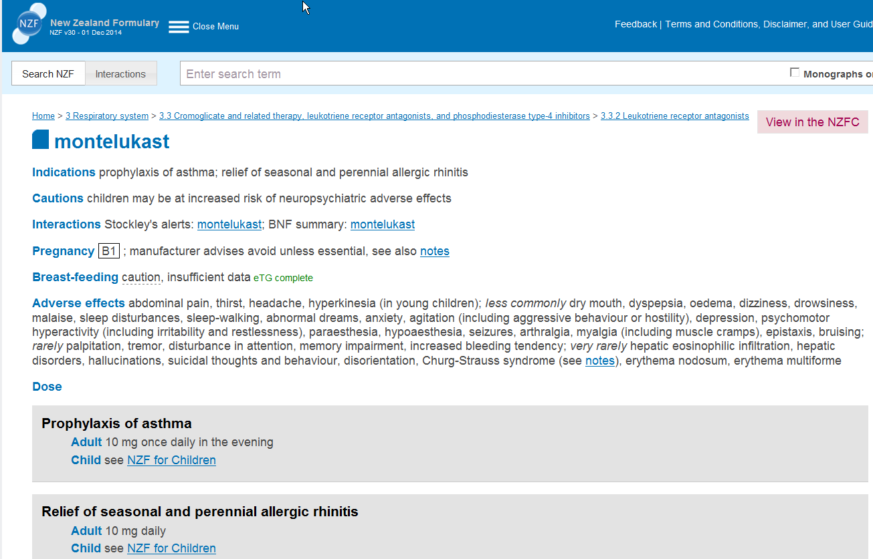
New Zealand Formulary
Notes:
Can type in Singulair but will give monographs in generic name.

Slide 24
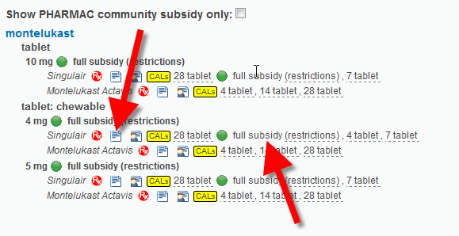
Handy Hints
Click for NZ DATASHEET
Hover mouse for
FUNDING RESTRICTIONS

Slide 25
Links to the datasheet
5 pages
Uses
Actions
Pharmacokinetics
Indications
Dosage & administration
Contraindications
Warnings & Precautions
Adverse effects
Interactions
Overdose

Slide 26
What information can I find in a datasheet?
Information provided by manufacturer regarding licensed:
- dosing
- route(s) of administration
- ADR’s as per the licensing clinical trials (+/- post- marketing surveillance)
- pharmacokinetics
- very limited information on special populations
Notes:
Special populations i.e. pregnancy and breastfeeding pt, renal impt etc

Slide 27
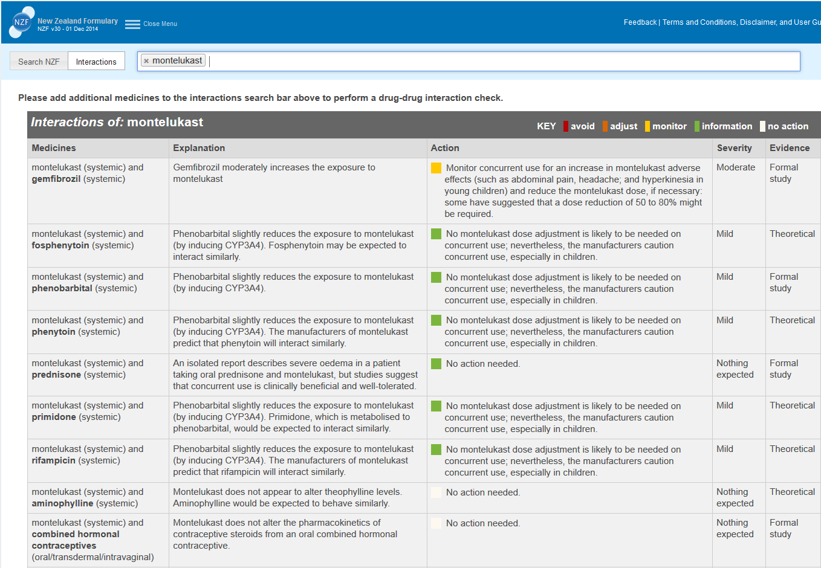
Click for drug INTERACTIONS

Slide 28
Clinical scenario Sudden onset shortness of breath (Resp04)
A 17 year old Tokelauan woman is admitted with an acute exacerbation of asthma. On the post-acute ward round the consultant asks you to prescribe Singulair
When she is discharged, what will it cost her to continue Montelukast?

Slide 29
Funding Status
Links to Pharmac website
Links to Special Authority forms

Slide 30
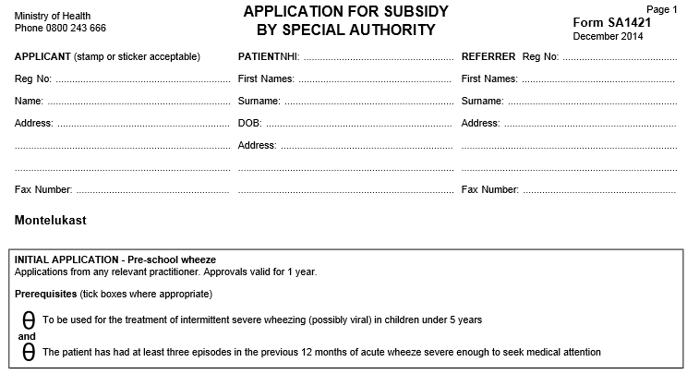
Special Authority
Notes:
Don’t forget to organise early to have electronic access to apply for special authorities for your patients – instantaenous approval in most cases. This will usually be covered during your induction.
Without special authority, best to contact the patients local community pharmacy for cost price on a ‘Private Rx’. Other options are exceptional circumstance exemptions like a NPPA etc.

Slide 31
Clinical scenario Pancytopenia (Blood07)
A 28 year old man presents to the Emergency Department after being unwell with fever (temperature up to 39.7°C). His full blood count shows marked pancytopenia with no detectable segmented neutrophils
The guidelines recommend piperacillin and tazobactam (and gentamicin) but the patient has anaphylaxis to penicillin. The registrar suggests meropenem.
Can you prescribe this?
Notes:
Is meropenem okay in patients with a penicillin allergy?
Does this fit in with my local antimicrobial stewardship guidelines (likely some differences between DHBs although the dream is to have at least regional guidelines
ADHB Antimicrobial Stewardship page available online

Slide 32
What did NZF say?
Meropenem:
Cautions sensitivity to beta-lactam antibacterials (avoid if history of immediate hypersensitivity reaction, see Hypersensitivity reactions)

Slide 33
ADHB Empirical Antibiotic Treatment Guidance: available online
Empiric IV treatment |  | Empiric po treatment | Duration of therapy | Pathogen directed treatment
Haematology | piperacillin-tazobactam 4.5g IV q6h ± gentamicin 5mg/kg IV q24h | Oral therapy not appropriate As above | A minimum of 72 hours to a maximum of 14 days | See full guidelines for advice
What did the SCRIPT App say? – ADHB antimicrobial
guidelines decision support –
Penicillin anaphylaxis: use Aztreonam & (Vancomycin)
Notes:
ADHB Antimicrobial Stewardship APP – Script App states use Aztreonam : NZF states: Cautions hypersensitivity to beta-lactam antibiotics. A beta lactam ring but not a penicillin.

Slide 34
HML
Why?
National consistency in access to medicines in DHB hospitals
No more postcode medicines
National funding of pharmaceuticals
1 July 2013
Shift to Pharmac being responsible for deciding which pharmaceuticals will be funded for use in DHB hospitals
Notes:
Where previously it was up to individual hospitals to decide which medicines would be used – usually via a Hospital Medicines Committee or Drugs and Therapeutics Committee, Pharmac took these decisions to a higher level in the tree from July 2013.

Slide 35
How does the HML work?
Prescriber restrictions
Indication restrictions
Local restrictions

Slide 36
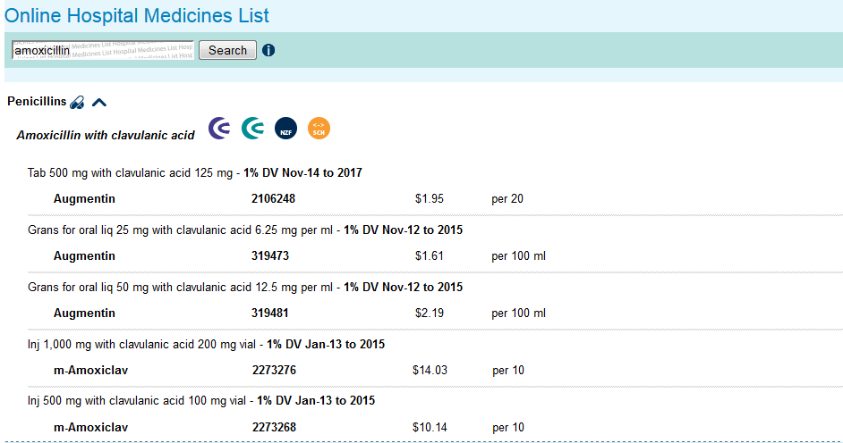
Hospital Medicines List

Slide 37
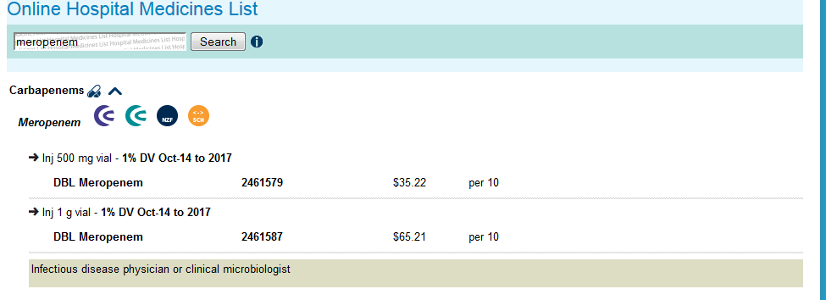
Prescriber restrictions
Notes:
Similar to specialist only medicines in the community.

Slide 38
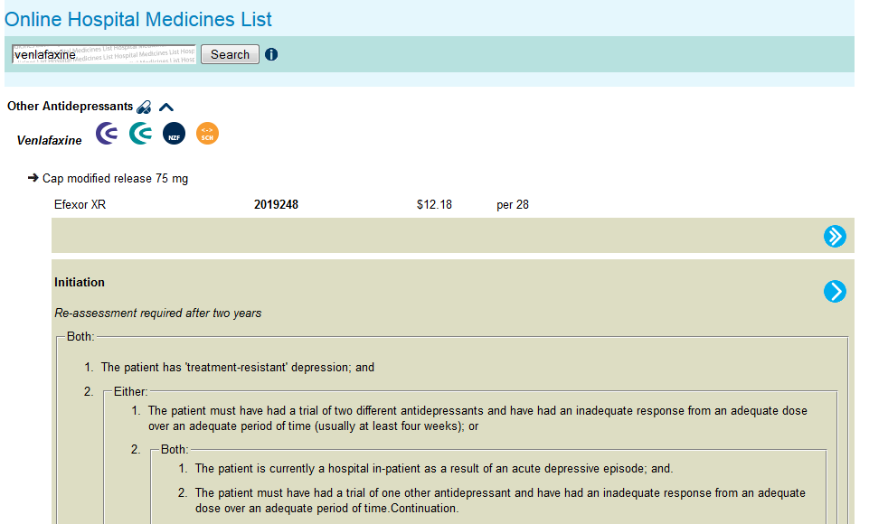
Indication restrictions

Slide 39
What if its not on the list?!
If patient already on medicine
Continuation of therapy (Rule 8)
If newly started in hospital
Requires approval from Pharmac for funding
Rapid Assessment (Hospital Medicines Committee)
Named Patient Pharmaceutical Assessment (Pharmac)
Notes:
Continuation – little old lady on rosuvasatin

Slide 40
The all important question...
As a Junior Doctor am I ever likely to need to look at the HML or any Pharmac publication for that matter?
Probably not.
However, you will need to be aware of limitations to prescribing

Slide 41
In summary….
Many resources available
National
Local
How to find them?
Variable in each DHB
No true “one stop shop”
Don’t be afraid to ask for help – find your pharmacist/pharmacy contact details
Notes:
Navigating through resources isn’t easy and there isnt a one-stop shop or a one-size fits all reference. It changes depending on which hospital you are at. We’ve gone through the broad resources to help guide you through treatment options and drug choices. But always be aware that there may be some constraints to which choice you have – whether that’s funding or ID approval/
Just remember you can always phone a friend (like a pharmacist) for help.

